Slide 1
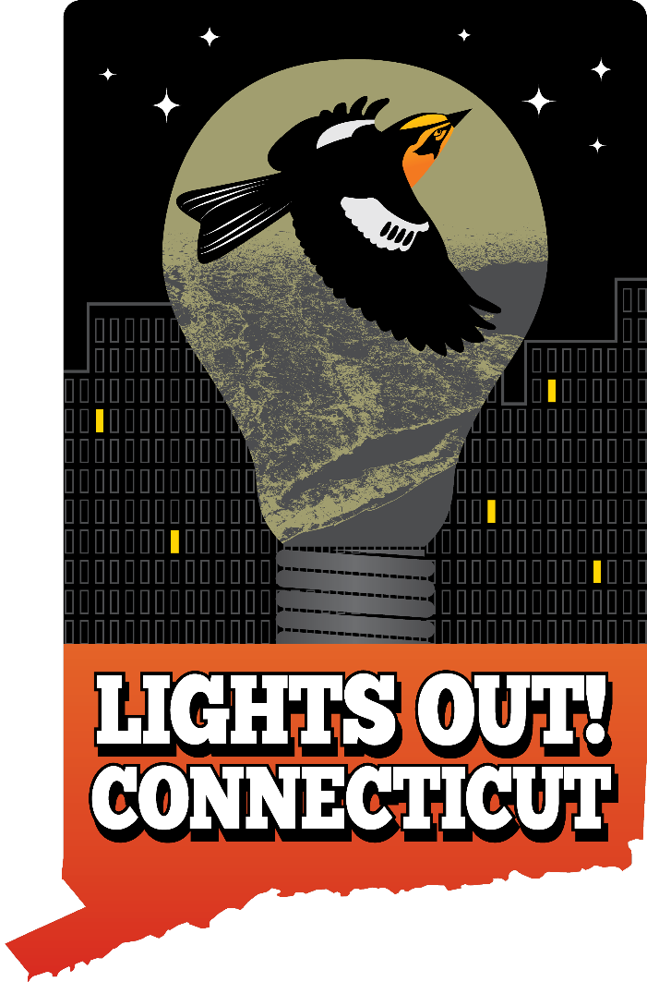
Lights Out Connecticut Local Leaders Kickoff Meeting
Oct 11, 2023
Notes:
Opening slide

Slide 2
Agenda
Welcome, Intro, & Highlights
Introductions (Group)
Local “Success Story”: Guilford
A Look at Municipal Lighting Laws + The Enforcement Challenge
Light Pollution Controls 101: Terminology + Basic Elements
State-level Rules: CT State Building Code, IECC, Public Act No. 23-143, Early Efforts
How to Convince Politicians & Businesses: Cost Savings + Climate + Biodiversity
How Lights Out CT Will Support You
Sharing Your Local Efforts (20 mins)
Q&A (15 mins)
Wrap-Up

Slide 3
Turning off 50% of lights reduced collision mortalities by 60%.
Source: Van Doren et al. “Drivers of fatal bird collisions in an urban center.” Proceedings of the National Academy of Sciences of the United States of America vol. 118,24 (2021).
Notes:
McCormick Place Lakeside Center Chicago. I have used this building as an example of the results of turning off just a fraction of the llghts. Does it go far enough?
A study published in June 2021 combines decades of surveys with weather records and radar data to pinpoint the impact of lighted windows on migrating birds. By turning off just half the lighted windows during spring and fall migration, the study revealed, fatal bird collisions could drop by 60 percent.

Slide 4
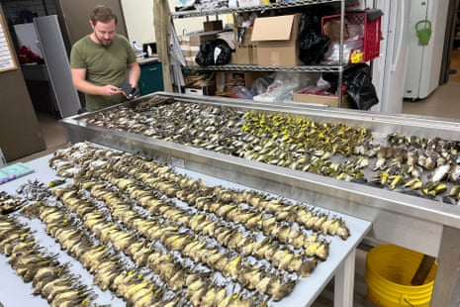
Source: At least 960 migrating birds, the highest number on record, died Thursday in “massive carnage” at McCormick Place Lakeside Center on October 5, 2023.
Notes:
Six days ago, at the same location 1000 birds were killed.
Although McCormick pace has taken steps to control their lights. The lights were left on for an event.
They were on schedule to have a bird friend building design ordinance to take effect that would have.
This case underscores the need to approach bird collisions by addressing both light pollution and widow glazing. And the sense of urgency.
We will address these needs this afternoon so that you the local leaders feel up to speed on the issue and ready to recruit help and to approach your policy makers.

Slide 5
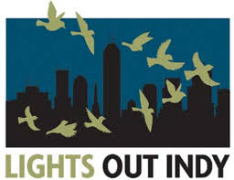
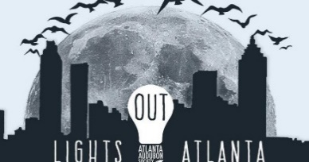
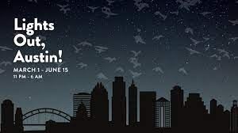
A Look at Municipal Lighting Laws + The Enforcement Challenge

Slide 6
Cities are leading the way in passing bird-friendly building laws.

Slide 7
Town and city-level rules can be comprehensive & effective.
Local governments across the country are adopting bird-friendly building rules at no additional cost to the jurisdiction.
City ordinances serve as examples to surrounding towns and cities.
New bird-friendly building laws are driving innovations and decreasing costs of materials.

Slide 8
Successful advocacy requires sustained efforts by a few motivated indviduals and local conservation groups over multiple years., typically 2-5 year
Good timing includes finding officials sympathetic to the cause.
Local data is important but not essential to initiate policy change.
Integrate Bird Friendly building regulations into local and state Green Building Policy initiatives.

Slide 9
The Five Principles for Outdoor Lighting

Slide 10
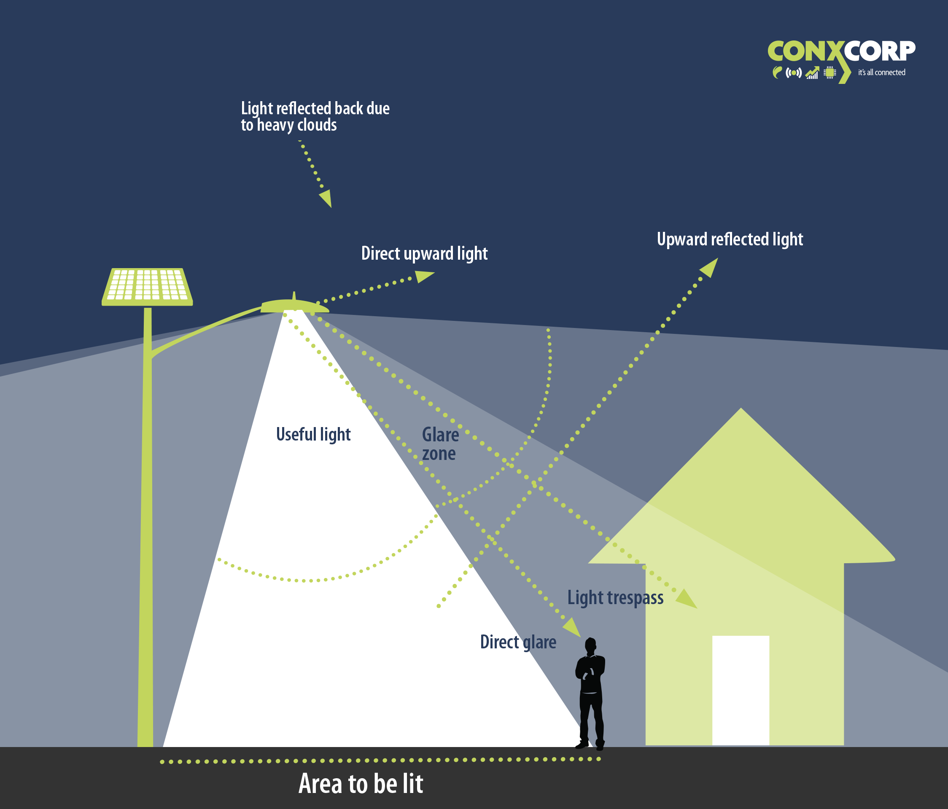

Slide 11
Source: International Dark Sky Association

Slide 14
State-level Rules: CT State Building Code, IECC, Public Act No. 23-143, Early Efforts

Slide 15
International Energy
Conservation Code (IECC)
C405.2.7.2Building facade and landscape lighting.
“Building facade and landscape lighting shall automatically shut off from not later than 1 hour after business closing to not earlier than 1 hour before business opening.”
48 states (incl. CT) subscribe to IECC as part of their state building code
Amendment Process at State Level allows for Changes
2024 IECC will be open for amendment in Connecticut

Slide 16
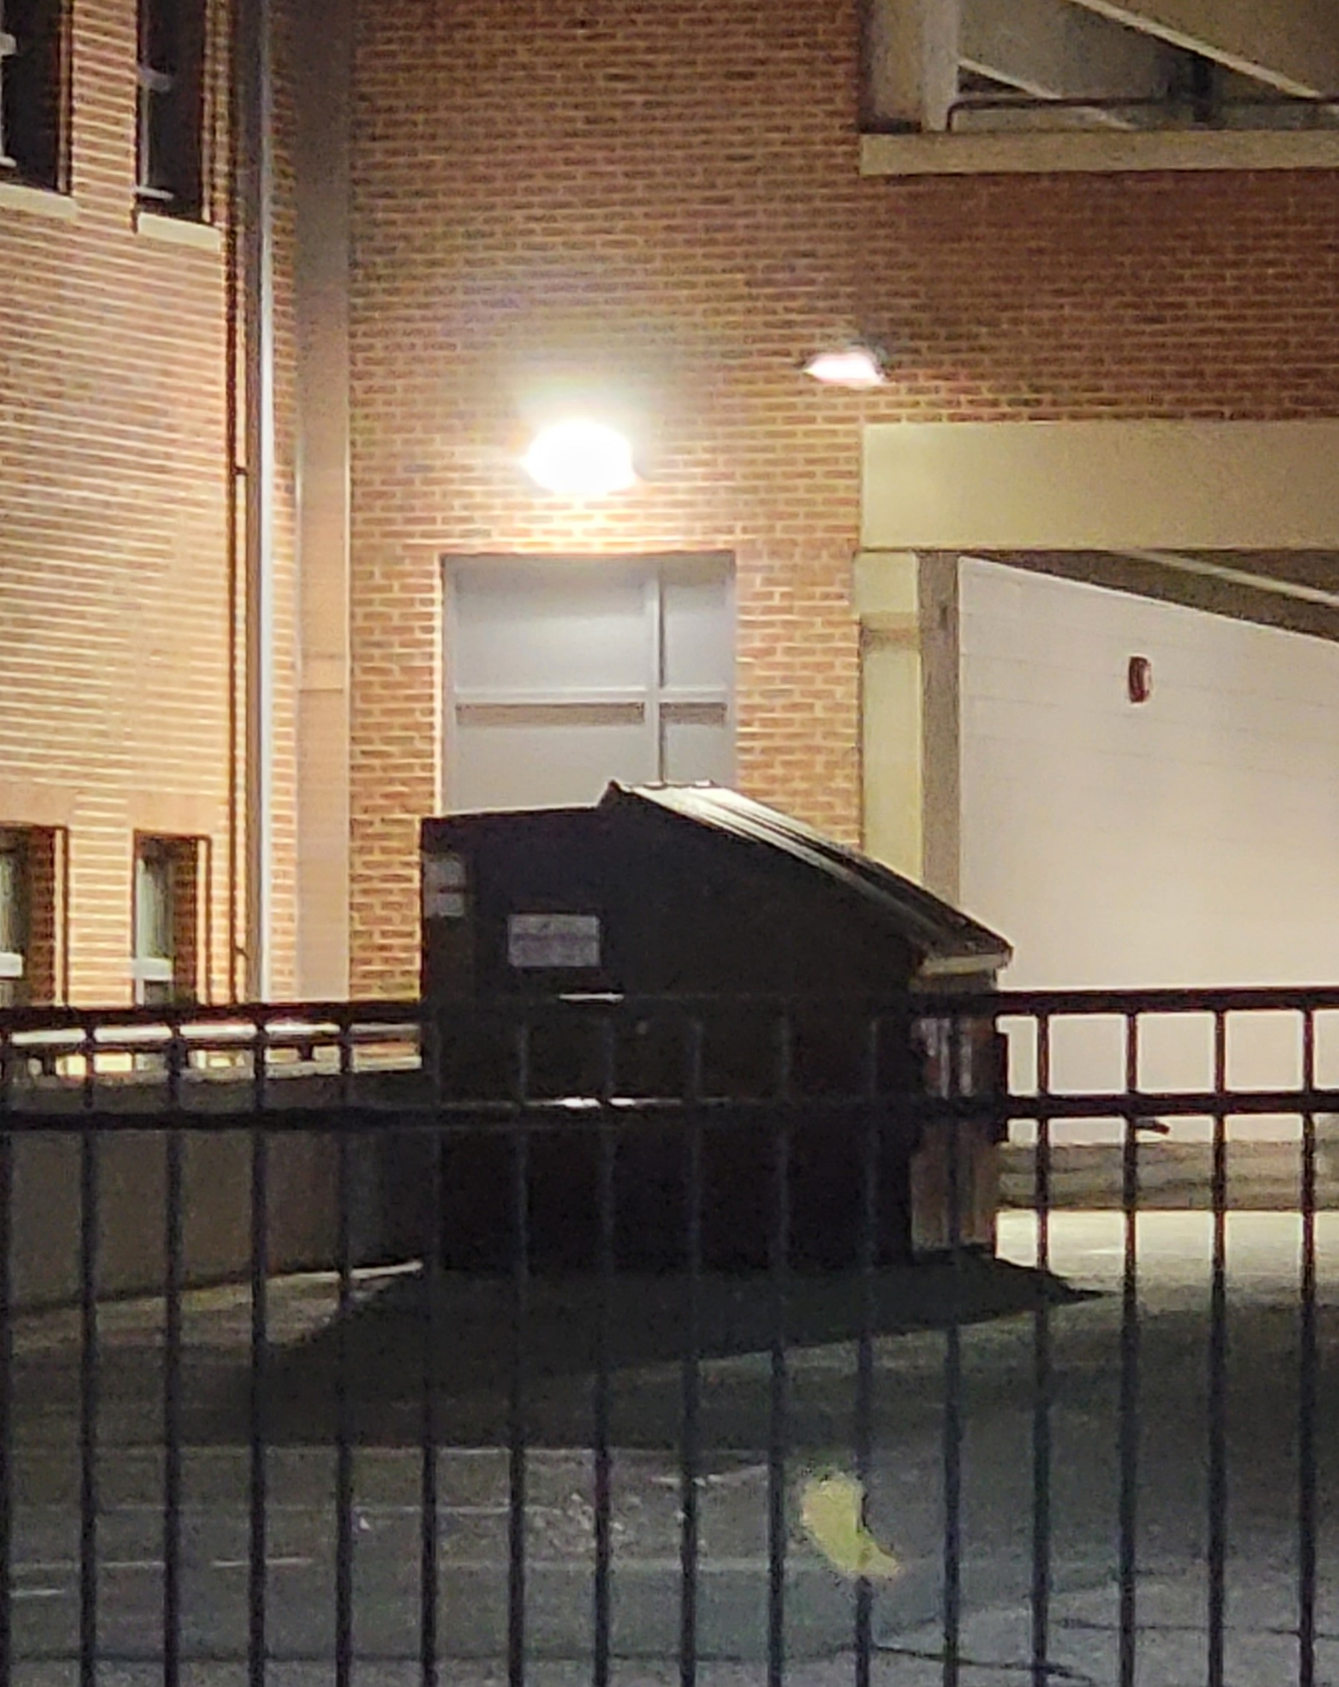
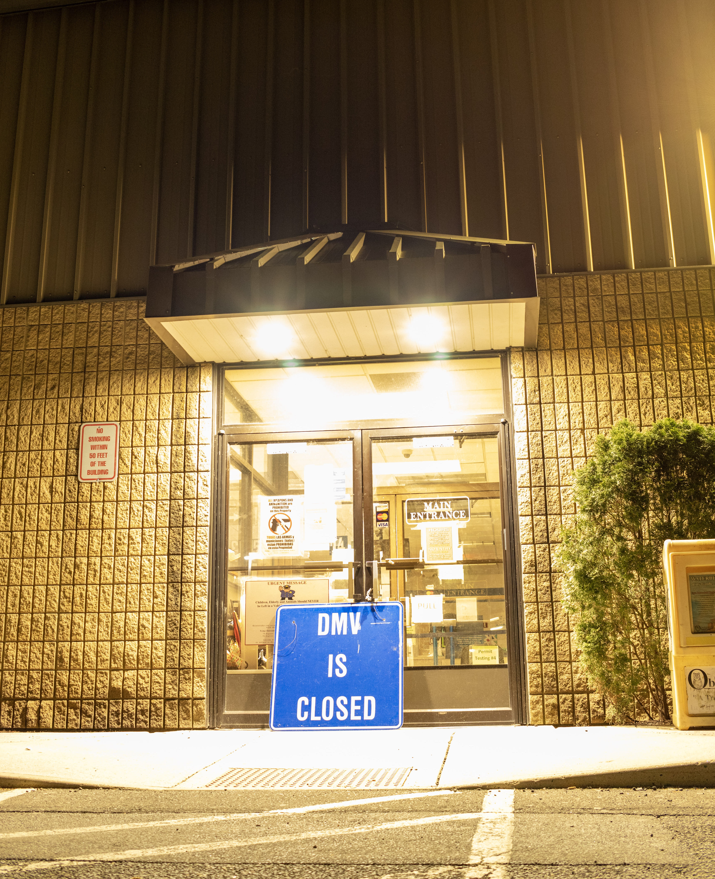
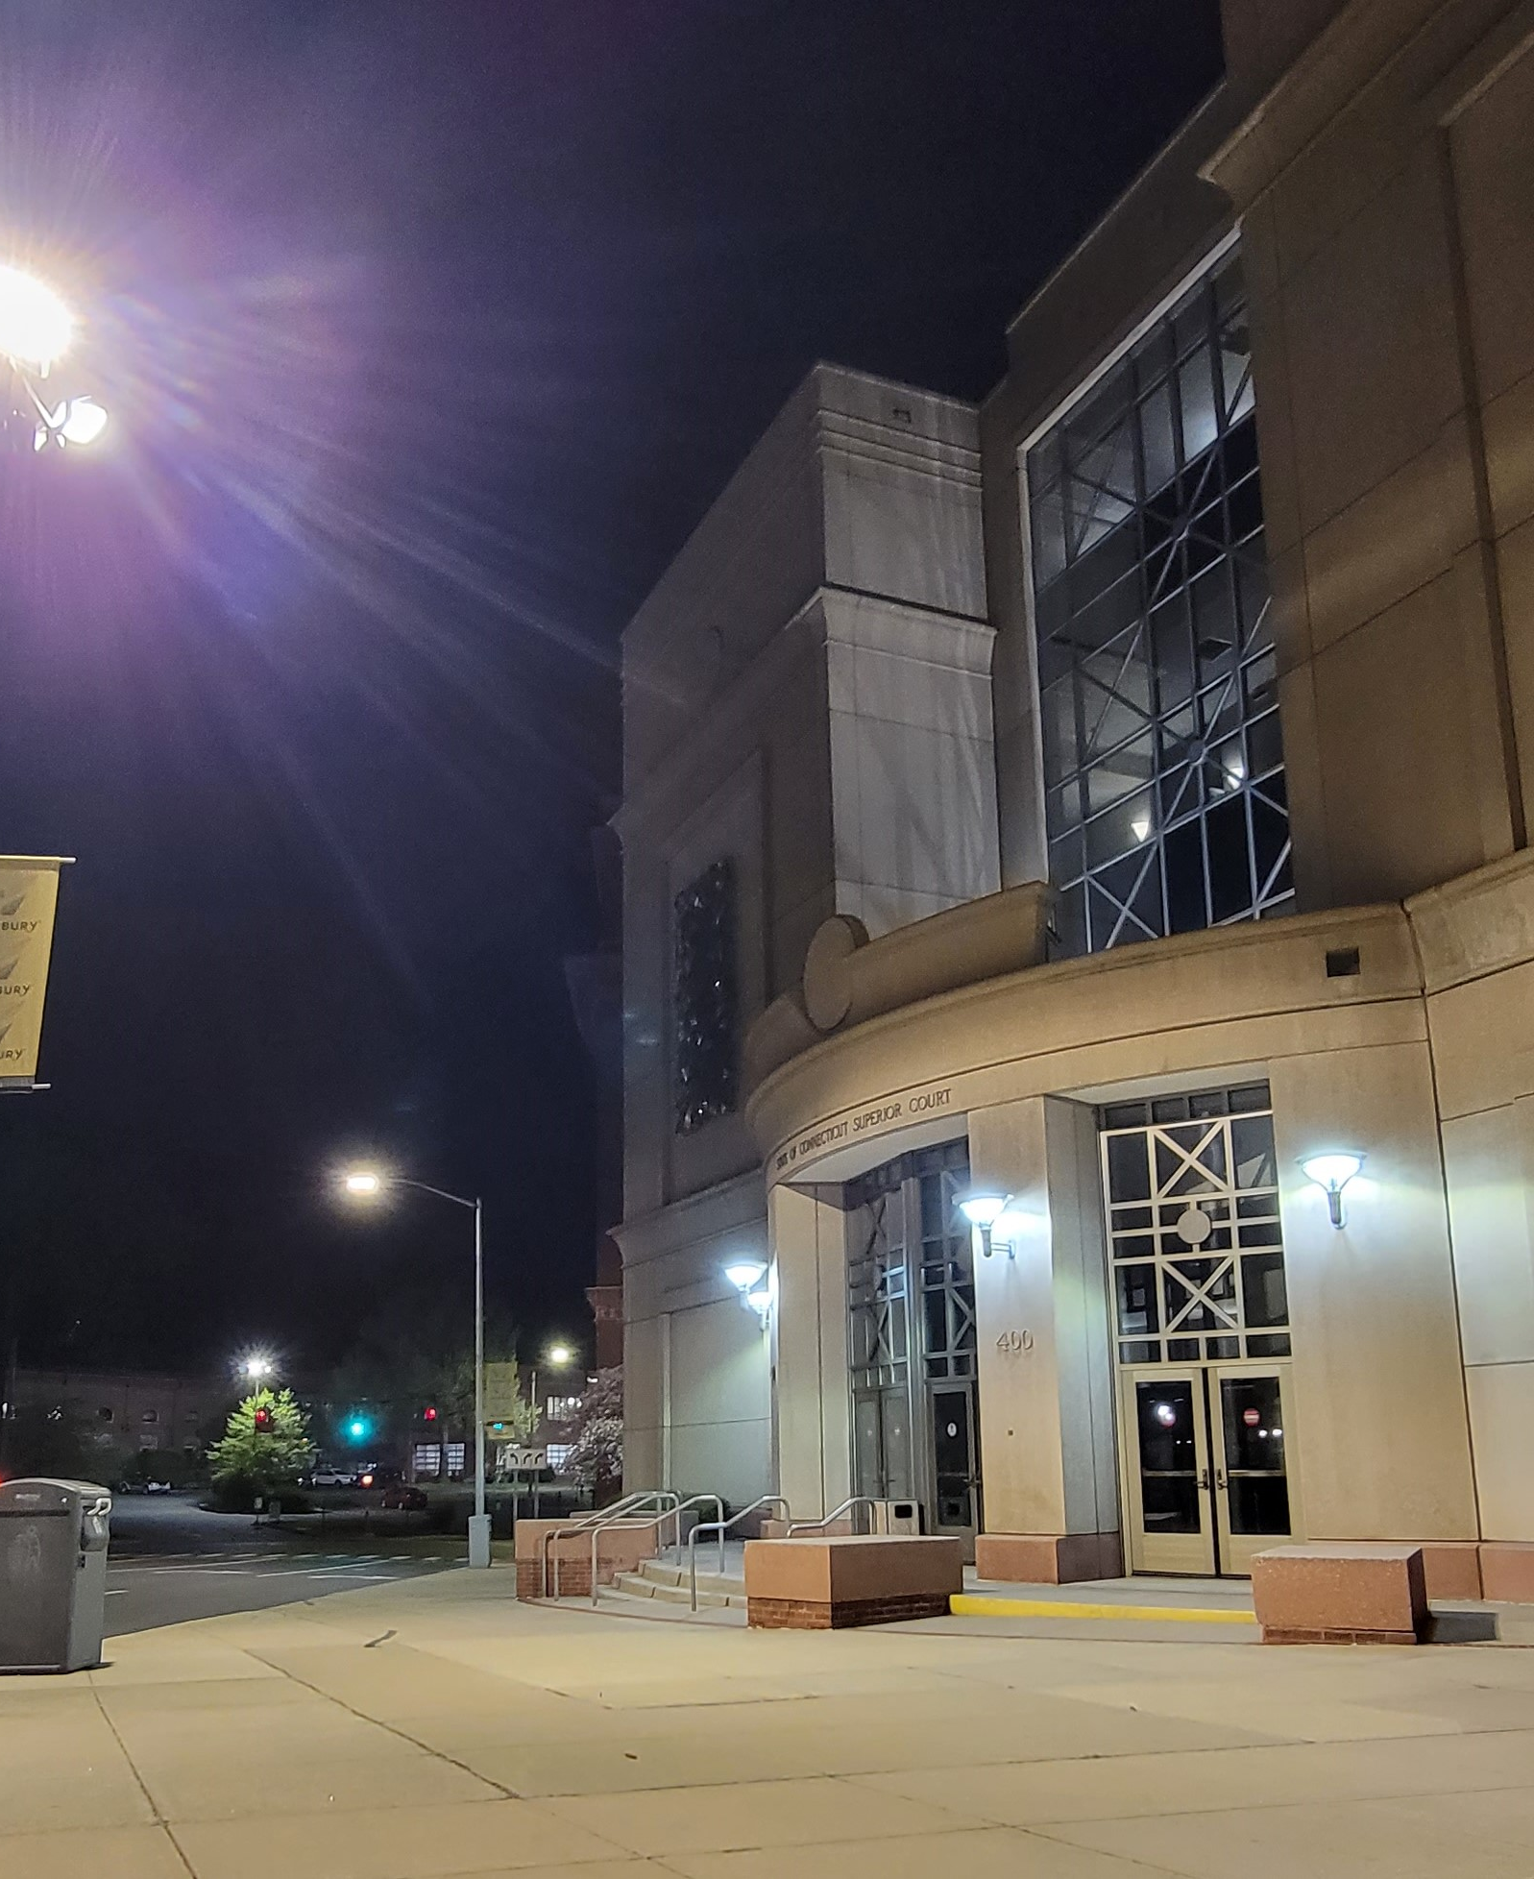
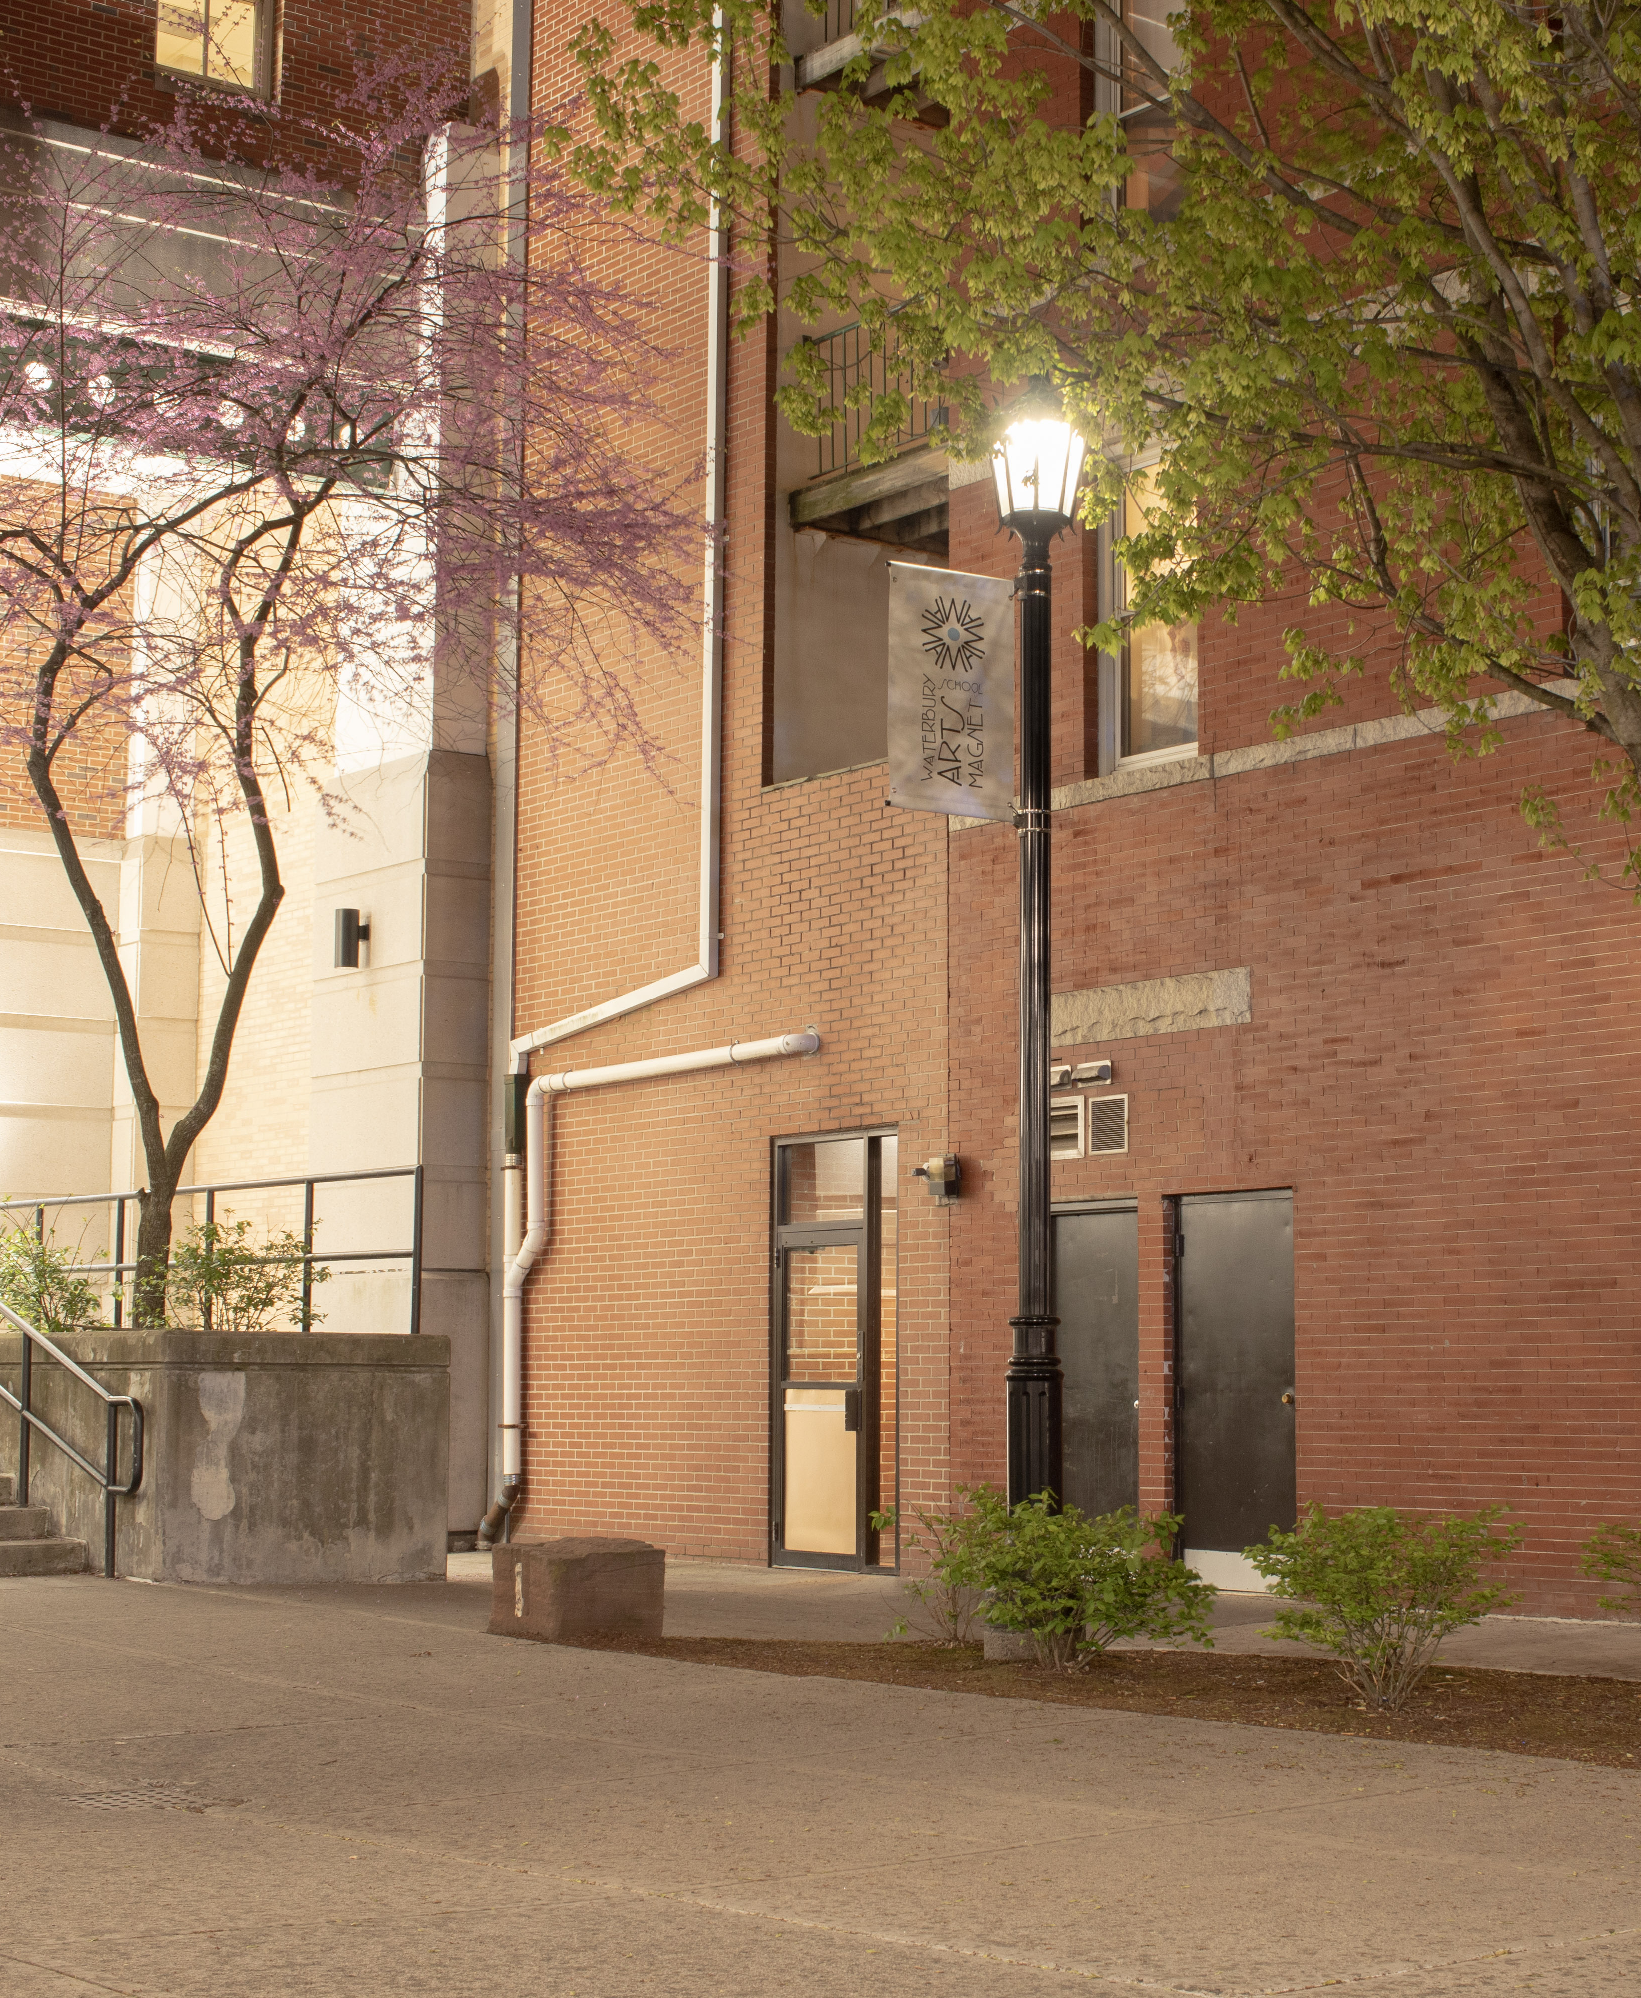
H.B. 6607, the “Lights Out CT” bill, is now the law of the land. It regulates outdoor lighting at state-owned buildings in CT year-round.

Slide 17
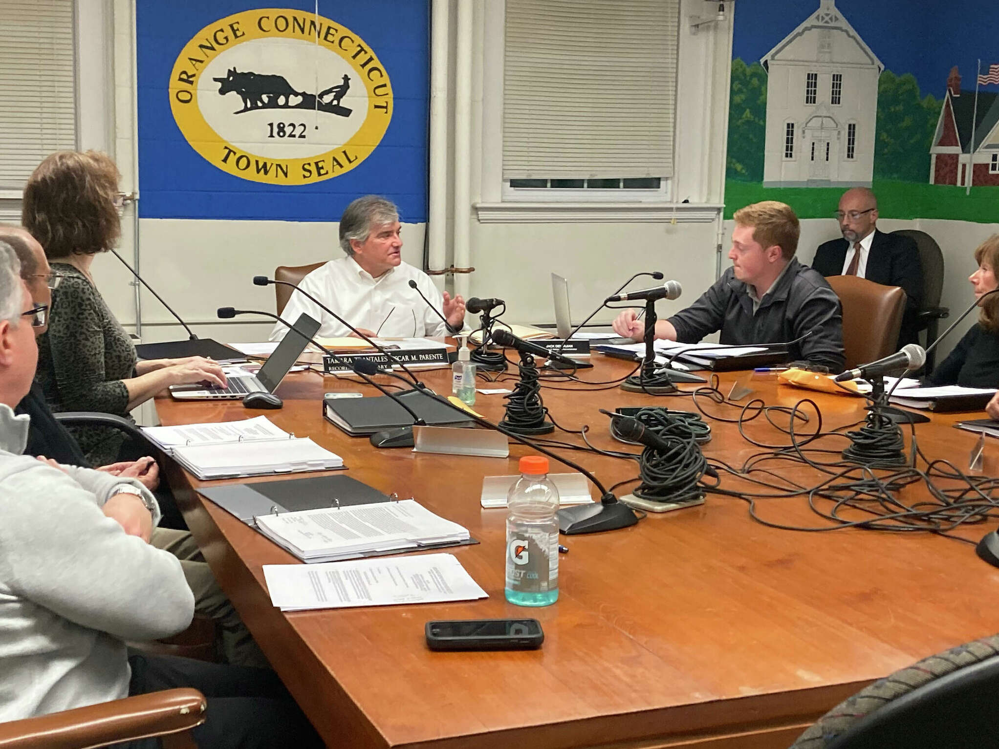
How to Convince Politicians & Businesses: Cost Savings + Energy Savings + Climate + Biodiversity

Slide 18
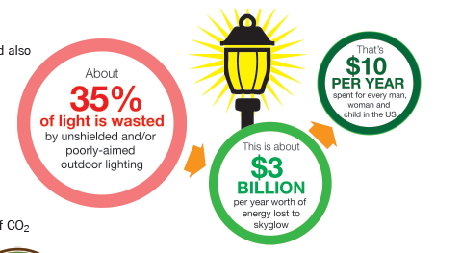
Cost Savings
Source: Int. Dark Sky Assoc., “Light Pollution Wastes Energy and Money” brochure.

Slide 19
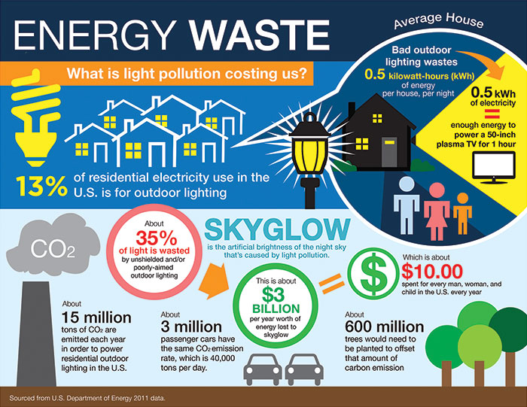
Energy Savings + Climate
Source: U.S. Department of Energy, 2011

Slide 20
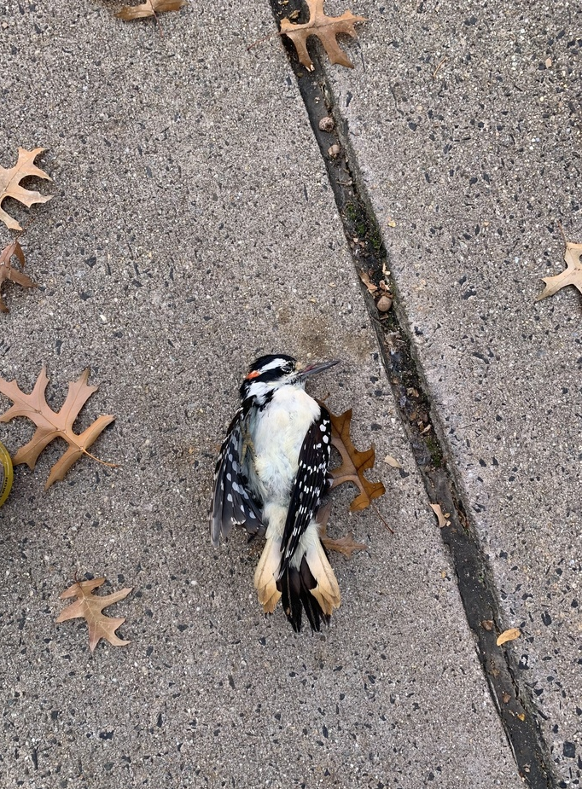
Preserve Biodiversity
WE HAVE LOST
3 billion birds in North America since 1970.
1 in 4 birds.
(Rosenberg et al., “Decline of the North American avifauna,” Science, Oct 4, 2019)

Slide 21
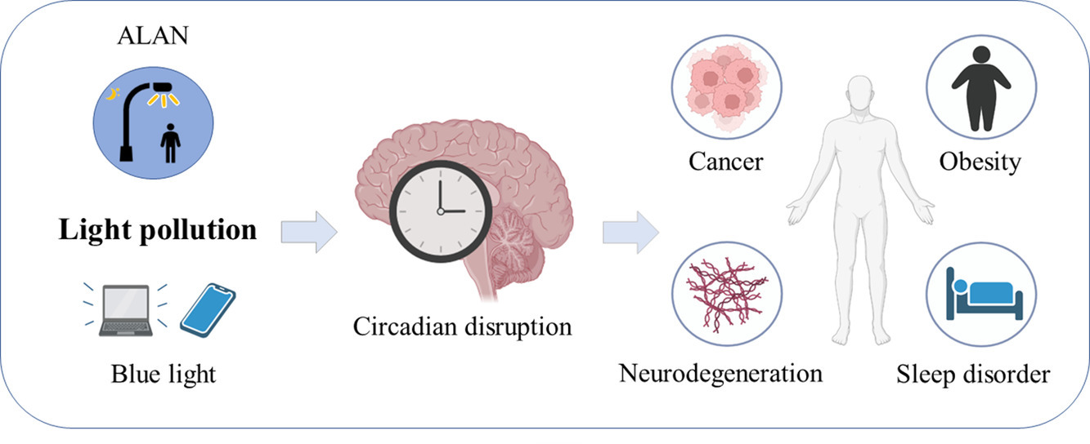
Human Health
Source: Miao Cao, “Understanding light pollution: Recent advances on its health threats and regulations,” Journal of Environmental Sciences
May 2023, 589-602.
Notes:
A growing body of research shows the importance of sleep for health, but millions of people don’t get enough of it. Research suggests that artificial light at night can negatively affect human health, increasing risks for obesity, depression, sleep disorders, diabetes, breast cancer and more.

Slide 22
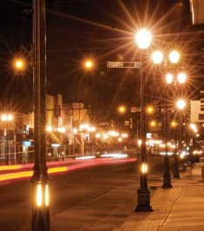
Brighter does not mean safer.

Slide 23
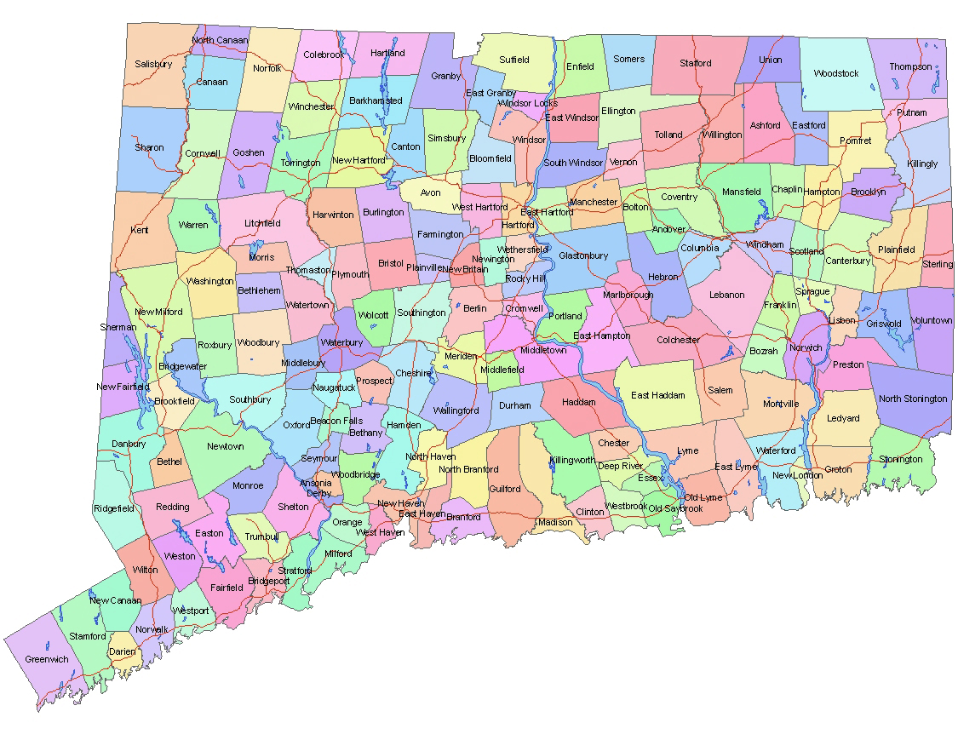
Sharing Your Local Efforts

Slide 24
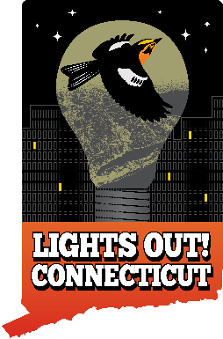
How Lights Out CT Will Support You
Provide technical assistance in analyzing and improving local laws
Share resources, like pamphlets and model legislation and ordinances
Make presentations, host events
Meet with local officials and councils
Support bird-strike monitoring and data collection

